Slide 1
Application of Bangladesh Metamodel
Model Simulation and Result Visualization
Md Mostafizur Rahman
Member, Metamodel Team &
Principal Specialist, CEGIS

Slide 2
Contents
2
Brief of Metamodel engine
Formulation of strategies/ interventions
Workflow to run Metamodel
Output result analysis
Group exercise
Live simulation

Slide 3
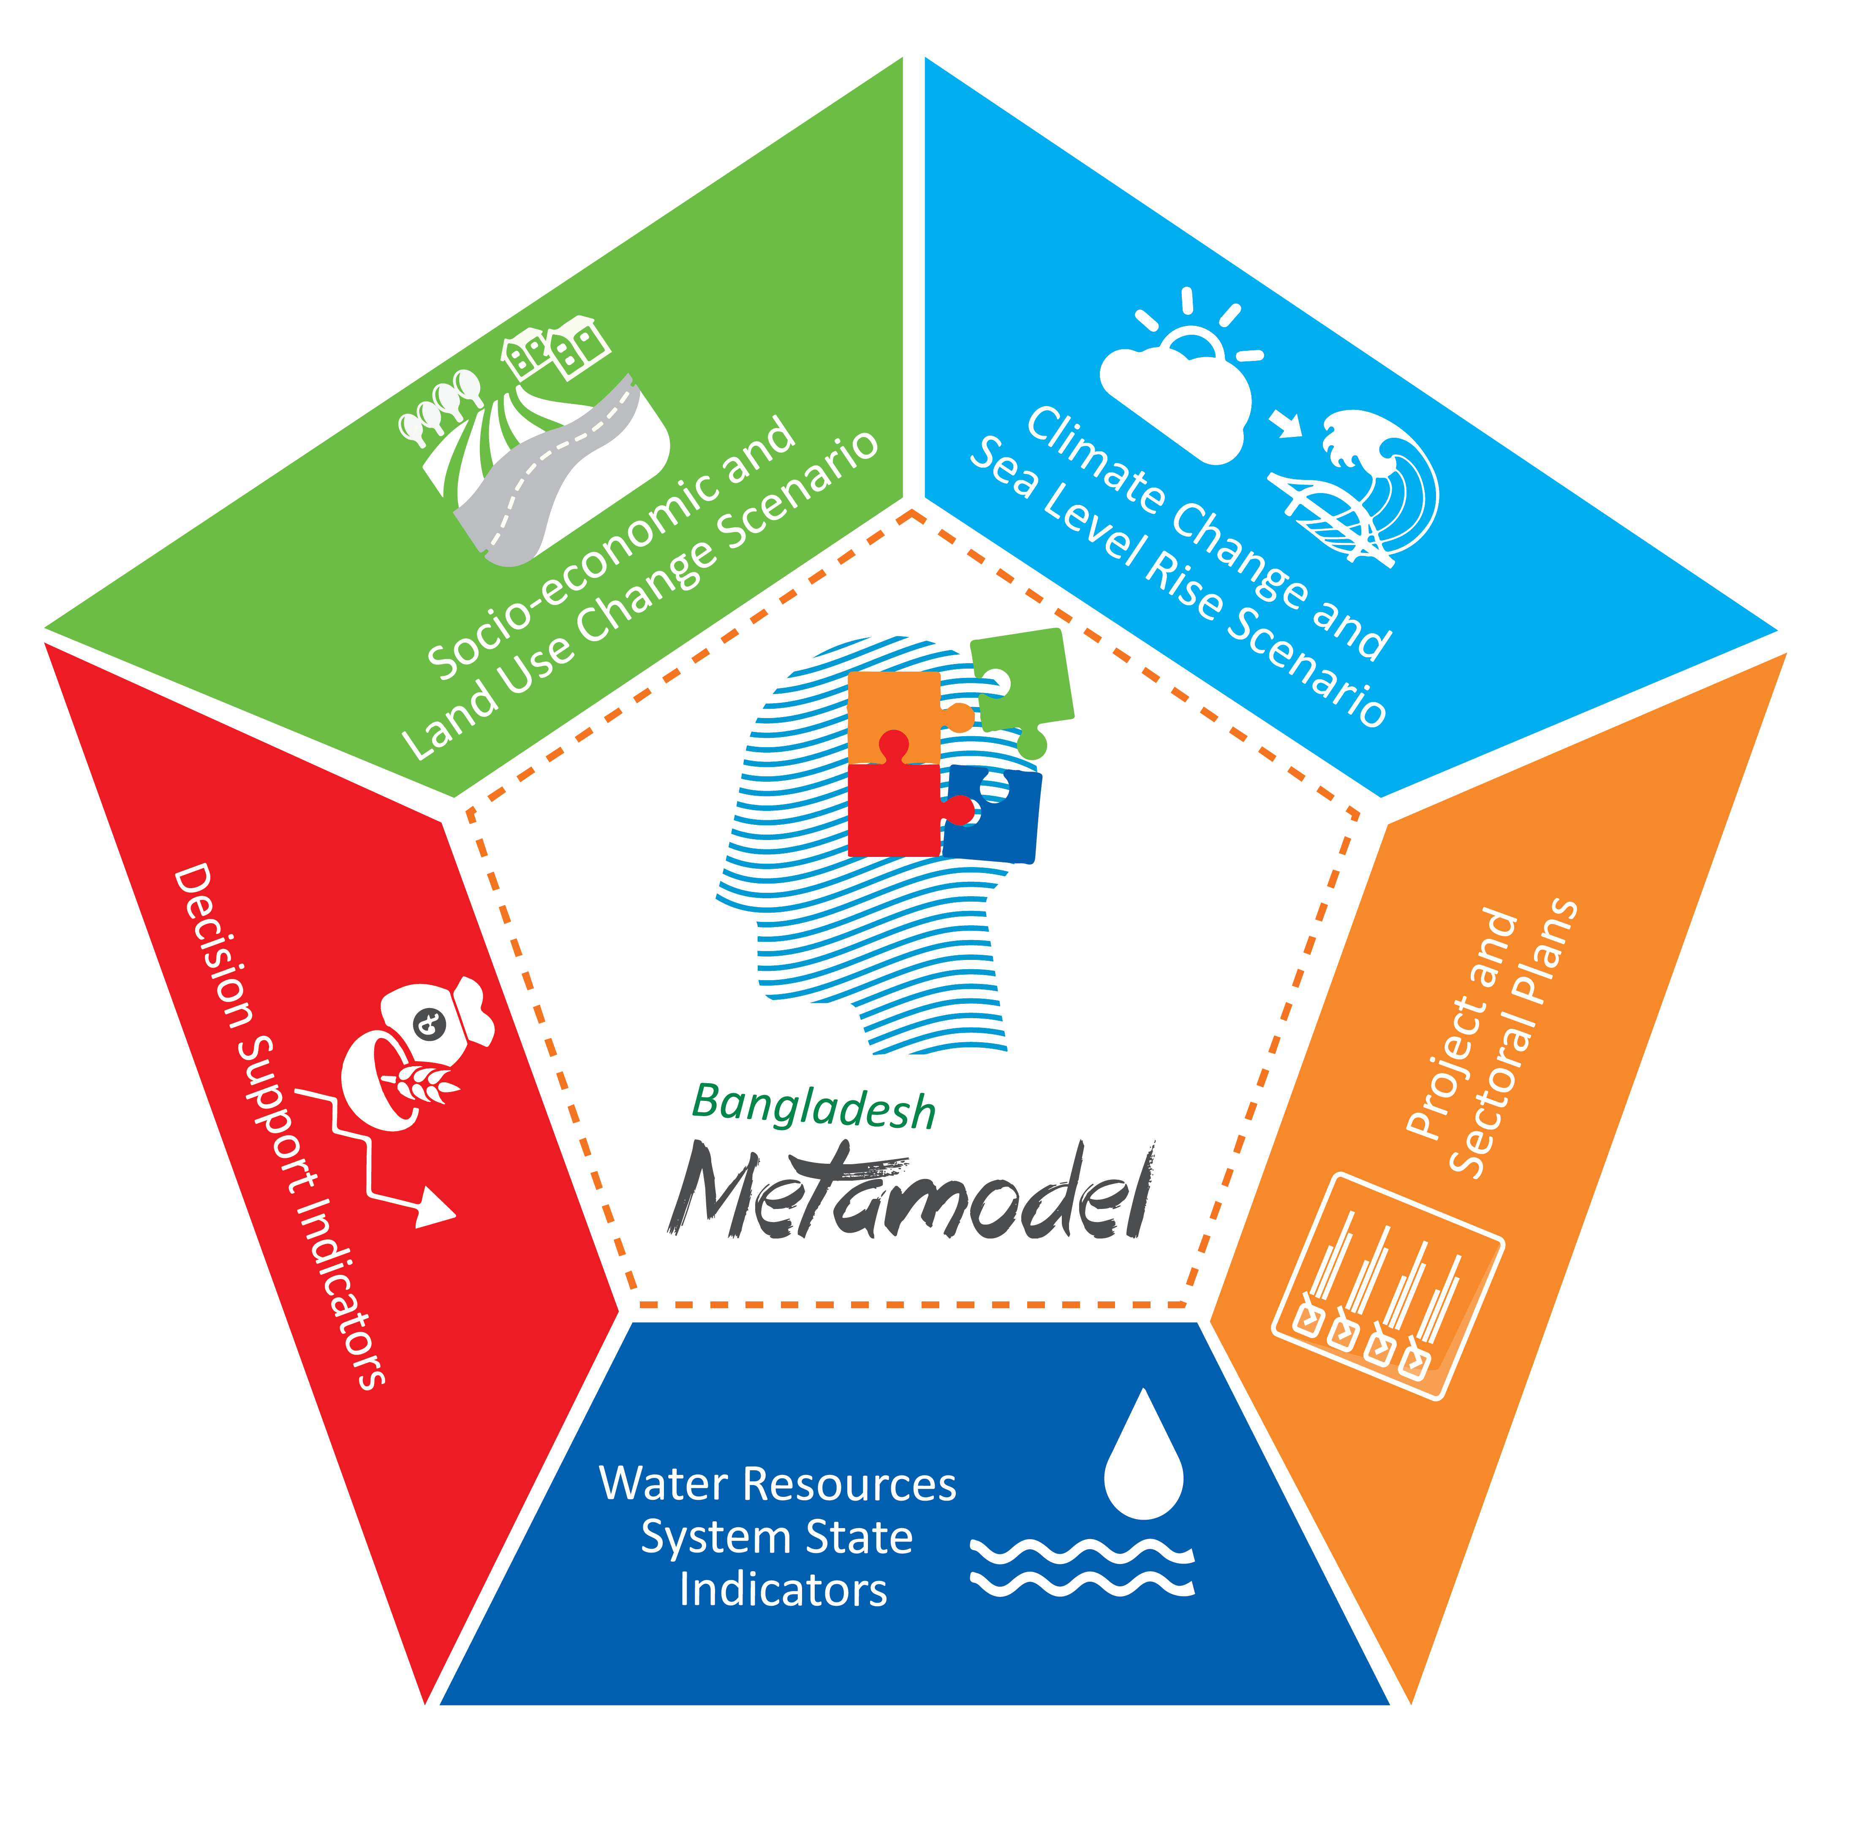
Developing the partnership for applied research by

Slide 4
Metamodel: In short
4
used for decision making
Simplified simulation
Based on results of detailed sectoral models
Integrations of sectoral models
Wide scope
Short calculation time
Less detail and accuracy in results
No replacement for detailed models
At planning level
Notes:
Short calculation time
Based on results of detailed, sectoral models
not a replacement for detailed models

Slide 5
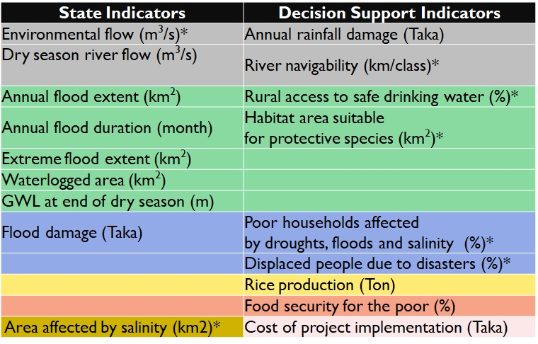
Metamodel Indicators
* Under development
Notes:
Ecosystem functioning indicators:
Change in low flow discharge (Q90)
Change in peak discharge (Q10)
Change in average annual inflowing volume (10^6 m3)
Timing of annual discharge peak (month with occurrence of annual maximum discharge)
Length of dry season: average number of months with Q<Q75
Area suitable for agriculture or fishing (?)

Slide 6
Metamodel components
Flood (damage) Module
Three major components:
Metamodel engine
Database
Dashboard
Food security
Initialization
Network Module
Salinity Module
Do Time Step
Framework
Water balance Module
Post Processing
Agriculture Water Demand Module
Agricultural Production Module
Input data
Case manager
Notes:
The metamodel contains of three main components:
engine, database and Dashboard
The central input database is an important component: structured, verified national data available on weather, climate, water, agricultural production, inhabitants, land use, projects, etc.
Case Maneger is also Imporant

Slide 7
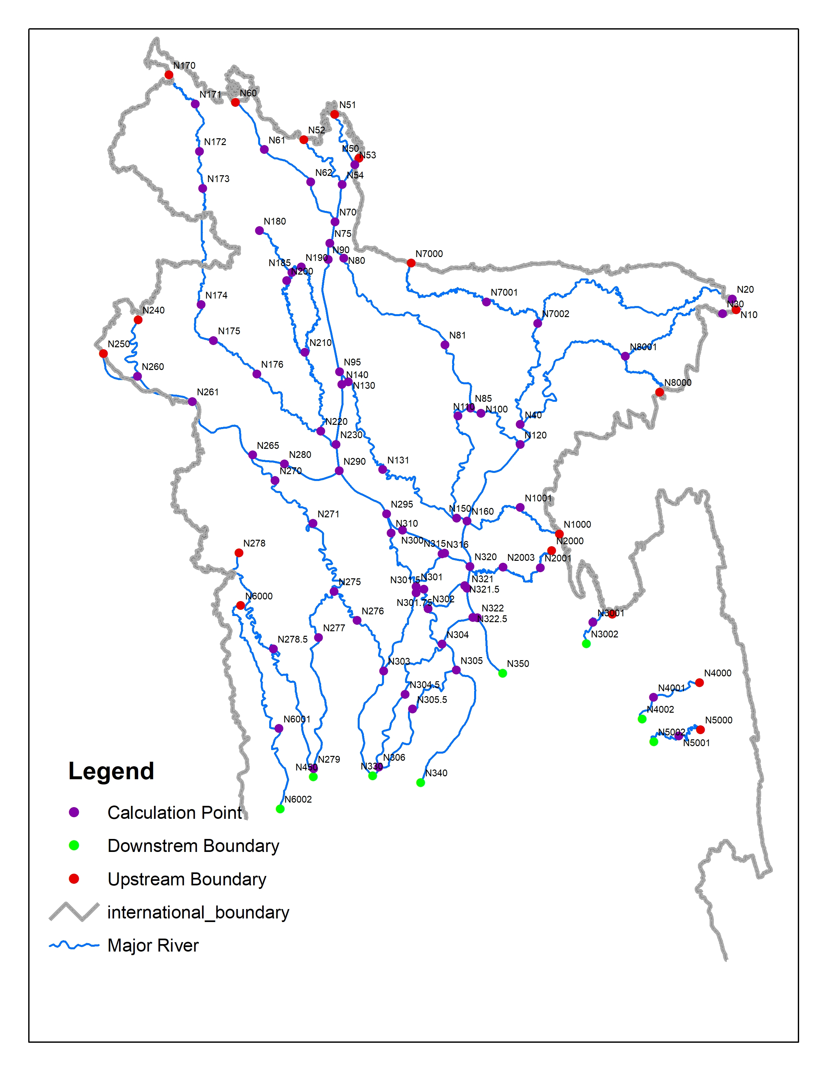
Network Module
To generate necessary output for Water Balance module and parameter which gives inputs to Agricultural Production module & Flood Damage Module
To describe transport of water through the major rivers of Bangladesh;
To calculate decadal discharge, water level, tidal range and salinity (based on detailed IWM MIKE-11 models)
Extent of Network Module

Slide 8
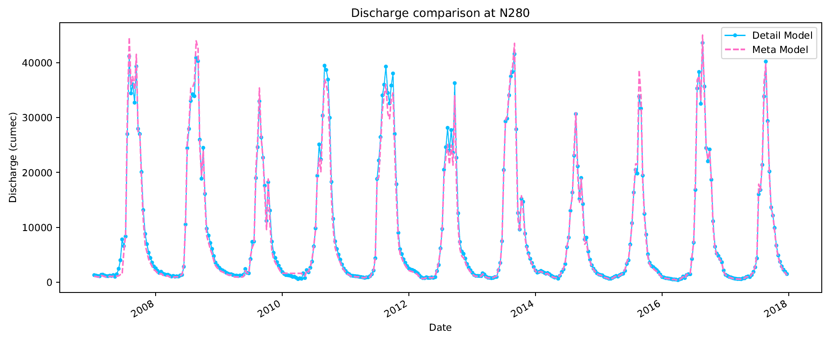
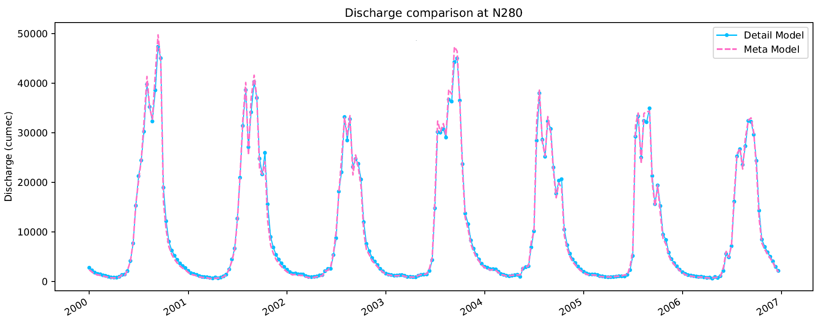
Calibration and Validation
Ganges River, Sujanagar
Node | NSE | PBAIS | R_square | .peakError | Log_NSE | Season | Categoty
N280 | 0.99 | 1.83 | 0.99 | -1443.89 | 0.98 | Monsoon | Calibration
N280 | 0.94 | 10.82 | 0.98 | 1364.86 | 0.93 | Dry | Calibration
N280 | 0.99 | -0.82 | 0.99 | -2424.77 | 0.99 | Monsoon | Validation
N280 | 0.96 | 10.79 | 1.00 | 1161.84 | 0.97 | Dry | Validation

Slide 9
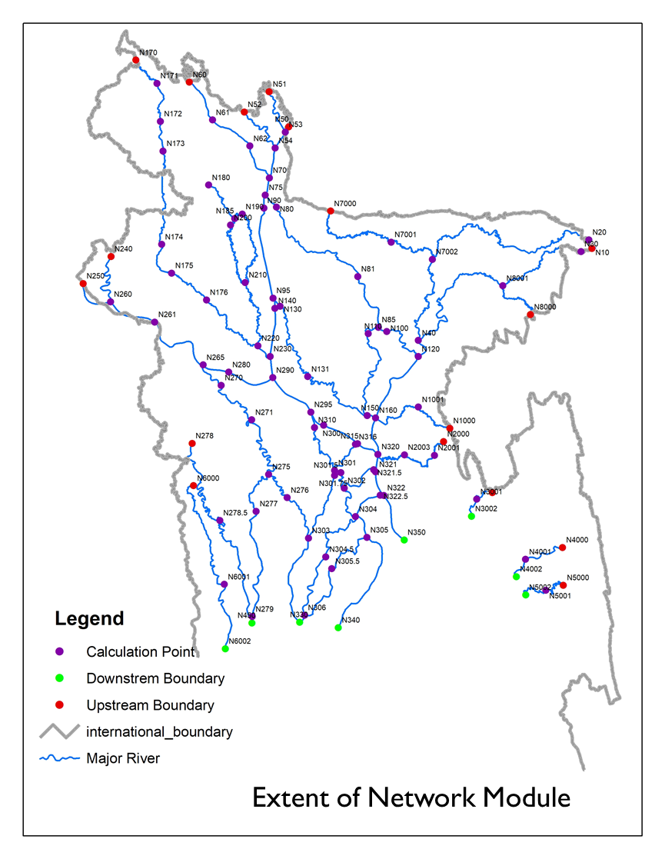
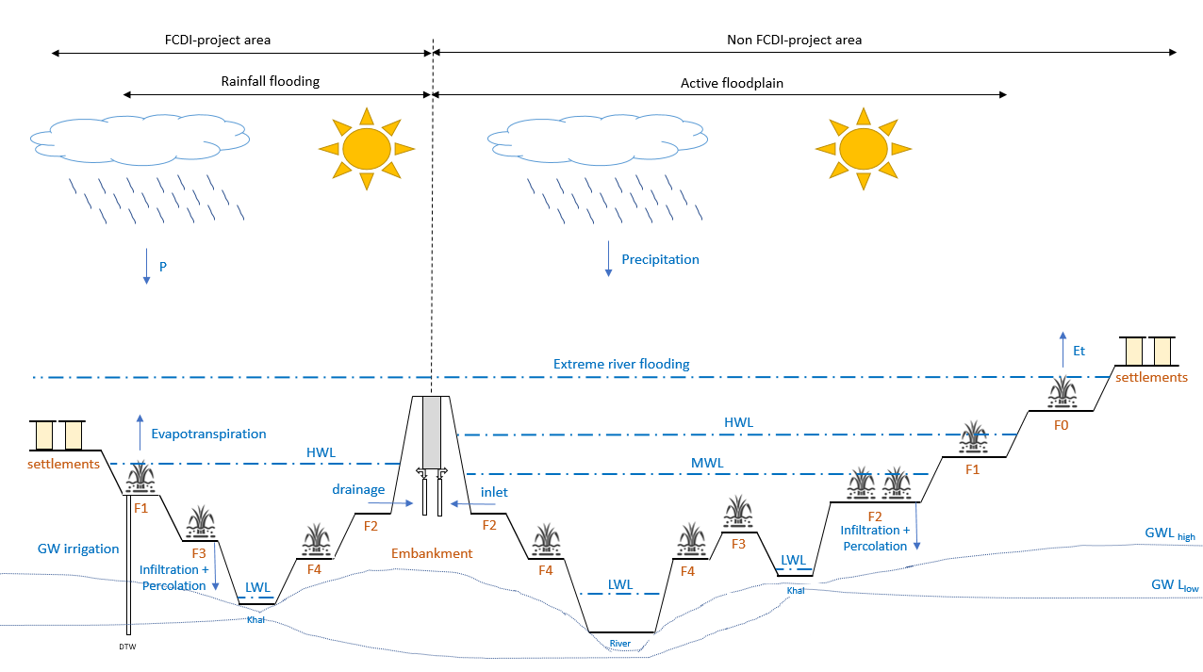
Water Distribution
Precipitation
Vertical distribution of water;
Horizontal Distribution of Water
Shortage of Excess of Water at Field Level
Evapotranspiration
GW Irrigation
Drainage
Inlet
Infiltration + Percolation
provides flood extents, flood duration, GWL at end of dry season and waterlogged area
Notes:
In the following slides we try to give insights in the conceptual model of water distribution in Bangladesh and several model input and assumptions. Please provide comments for further improvements.
You see here a typical, very much stylized sideview of a Bangladesh floodplain for a certain upazila. The waterbalance concepts are mainly build upon previous works from all types of institutions in Bangladesh, described by Brammer, amongst others. It is tried to keep the waterbalance as simple and effective as possible, targeted at the main objective of the Metamodel.
At the highest level we distinguish within an upazila (our main calculation unit) between FCDI-project area and non-FCDI-project area (BWDB project area). We further adopt the classification of flood landtypes for the agircultural areas in order to be able to connect with crop rotations and patterns in the water demand and agricultural production modules, plus 5 other landuses (settlements, forests, permanent waterbodies, river and shrimp areas). So theoretically, each upazila in Bangladesh is divided in 10 landtypes and again in 2 areas (protected and unprotected). Further, it communicates with one of the 105 nearest and hydrologically informed network nodes (see the image on the top), in order to drain water (in times of excess) and to ‘flood’ lands from the river or let water in during dry season.
Finally, each of the 20 landtypes in an upazila is considered a separate balance, for which a each timestep the waterbalance is calculated. Each ‘balance’ includes general vertical processes as precipitation, evapotranspiration, soil infiltration and percolation to deeper grounwater, as well as horizontal processes, as local runoff, water inlet or overbank river flow. Man-made hydraulic structures like main embankments, regulators, irrigation schemes are included and can be operated, as well as non-hydraulic structures as road obstructions, land uses with ‘resistance’ properties are included. Small-scale SW irrigation (LLPs) is not explicitly modelled.

Slide 10
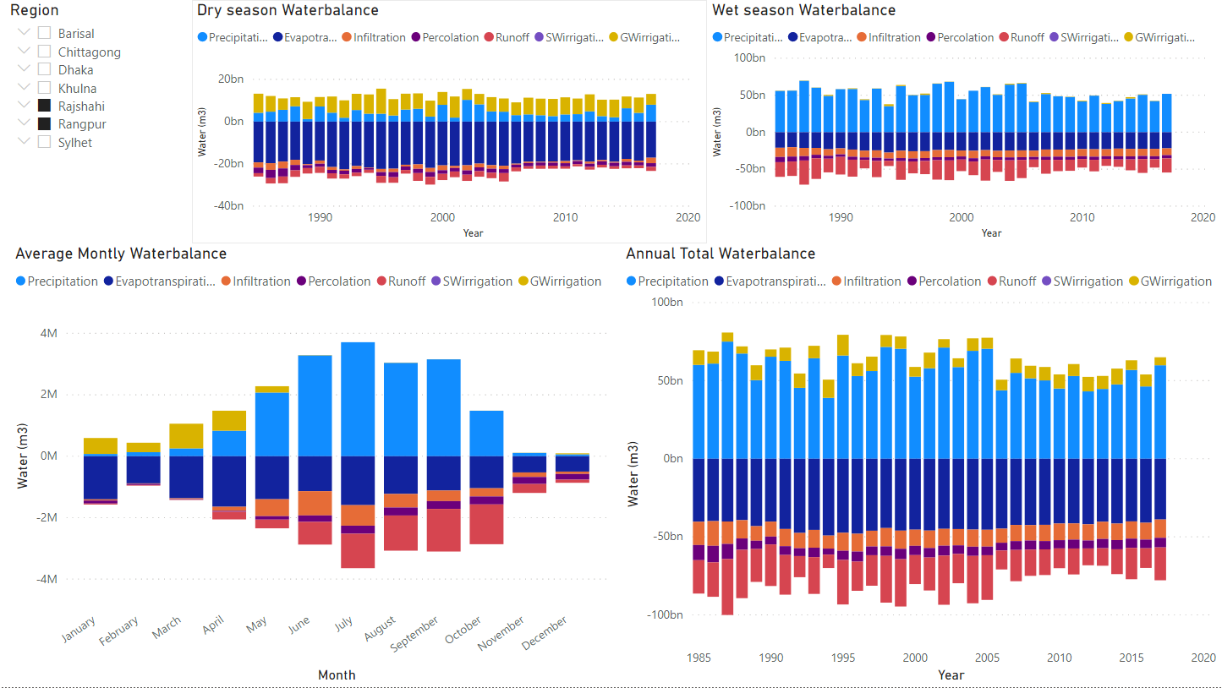
Water Balance Module output for NW-region (base run)
Observations:
1. Clear seasonal diff
II. Large annual variation
III. Residual moisture supplemented by GW irrigation in beginning of dry season
Available for every district in Bangladesh (currently calibrated for NW-region)

Slide 11
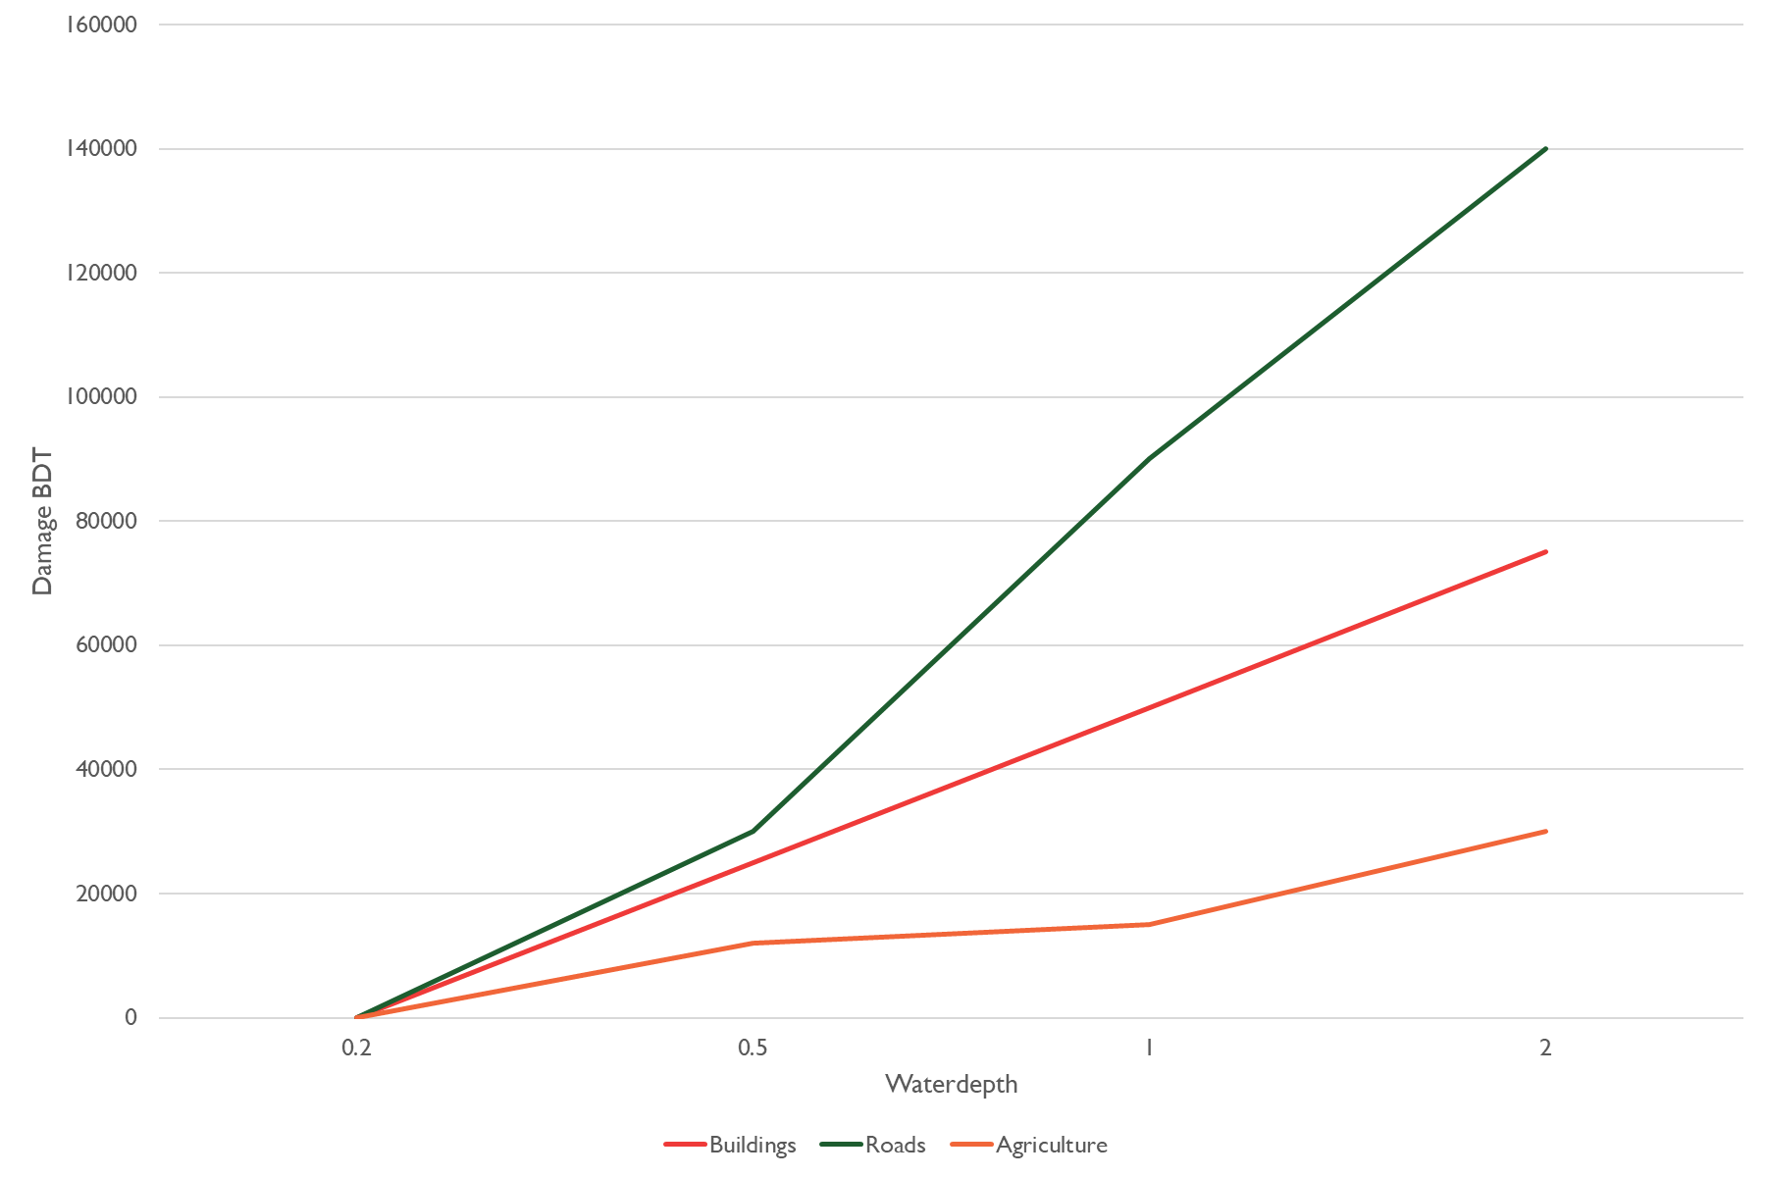
Flood damage and losses module
Estimates flood impacts to population, road infrastructure, buildings, agriculture and embankments
Based on well established unit-loss method and data from scientific literature
Max. water depth (hazard)
Exposure (value)
Vulnerability
(damage factor)
Damage in BDT
Persons affected
Damage (BDT)
Waterbalance result
BBS, RHD, LGED, BARC, BWDB
Waterdepth (m)
Literature
(N. Islam, BIDS)

Slide 12
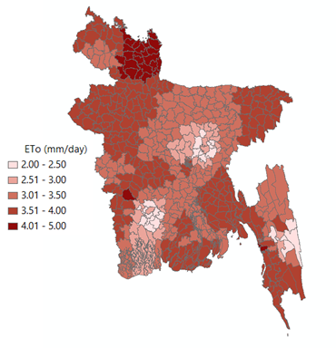
Water Demand
Objective
To estimate amount of water needed to meet water loss through evapotranspiration from crop land, forest land, fallow land, settlements and waterbodies.
Specific objectives :
1. crop water demand per crop per upazila on decadal basis.
2. loss of water through evapotranspiration from forest land, fallow land, settlement and waterbodies by upazila on decadal basis.
Crop water demand (m³/decade)
Crop Water Demand (CWD) = (10*EToi * Kci)/1000 *Acrop*10000 = EToi*Kci*Acrop*100
Penman-Monteith (FAO, 1988): Estimation of Decadal ETo (36 BMD station) and station data interpolated to Upazila by IDW (Inverse Distance Weighting) method.
BARI, 2018, MPO,1987: Crop coefficient (Kc)
Crop data (district) from Yearbook of Agricultural Statistics-2018
Crop coefficient
(BARI, 2018, MPO,1987)
Land type (F)
BARC, 1998
Per season:
Area per crop per landtype in an upazila →
Total water demand
Documentation available: http://jcpbd.nl/bdpMetaModelDocs.php
Notes:
CWD is crop water demand (m³/decade)
EToi is reference evapotranspiration (mm/day) at i th decade
Kci is the crop co-efficient at i th decade
Acrop is Area of Crop (hectare)

Slide 13
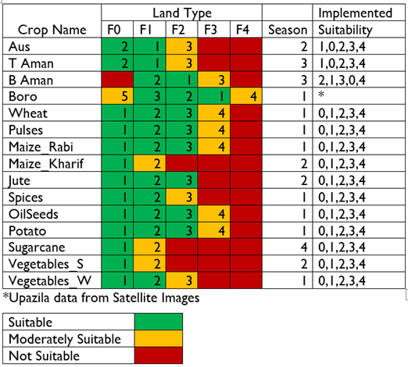
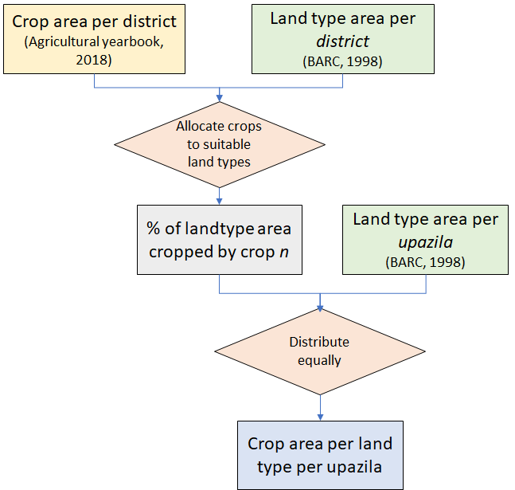
Results: Crop distribution (District to Upazila)
Input for the Metamodel ( Colomn Suitability 1 = highest and 4 lowest)

Slide 14
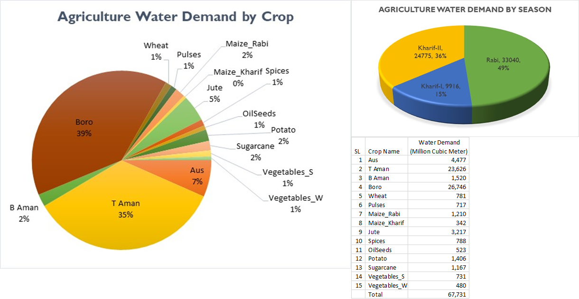
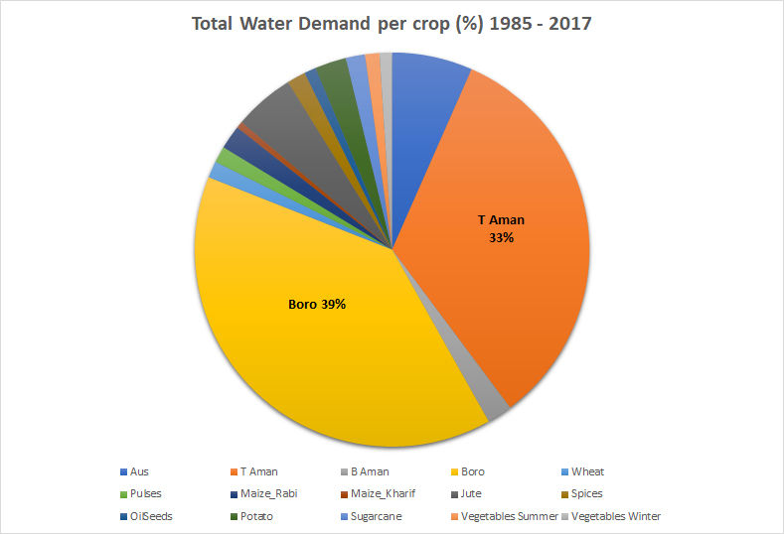
Results: Water Demand from meta-model engine
Notes:
Input Rashid figure

Slide 15
Agricultural production
Maximum yield (Agricultural book 2011-2018)
Drought damage
(total deficit water during growing period)
Flood damage
(flood occurrences,
% submerged and duration)
Actual yield
(tonnes, per crop, upazila)
Goal
Actual crop yield of 15 crops
Agricultural production (Important considerations)
Input from other modules water demand (water demand, cropping area) and water balance (water supply, flooding depth)
The potential yield is reduced by flooding and drought damage (FAO, 2012)
Calibration: Crop yield (district) from Yearbook of Agricultural Statistics-2011 – 2018 (include damage from flood events)
Documentation available: http://jcpbd.nl/bdpMetaModelDocs.php
Notes:
*Calculation steps

Slide 16
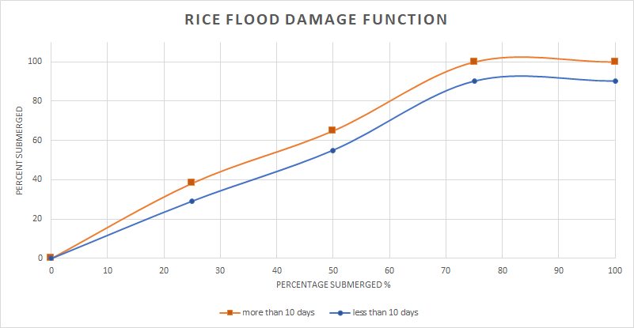
Agricultural production
Data
Agricultural yearbook:
Chapter 3. Potential yield (63 districts, 7 years, 10 crops) ~4000 data inputs
Chapter 4. Crop damage due to events ~300 data inputs
Drought damage
Coefficient Kd = Total deficit / Total demand
Flood damage
Coefficient Kf, damage function. This depends
on days of submerged and % submerged
Rice plants height ~1.2 m
(developed from: Hussain, 1995)
Ky
Flood damage

Slide 17
Food Security: our approach
FS composite indicator
ADESA
Food Stability
(flood and drought disaster, included in rice & wheat)
Food Availability
(total supply)
Food Accessibility
(income)
Food Utilization
Goal
Average Dietary Energy Supply Adequacy (ADESA) for the lowest income ( lowest 20% income quantile)
Pillars of food security
Availability Total supply (import & production, rice and wheat from modules, others (meat, milk, and others from data) translated to calorie intake per capita per day
Accessibility Income
Stability Reduced wheat and rice production due to disasters
ADESA: expected calorie intake for lowest income quantile combining all the above pillars
Developments
Income & production at district level?
Scenario projections: population, income, food import, other agricultural productions?
Calorie intake
(Population, calories)
Documentation available: http://jcpbd.nl/bdpMetaModelDocs.php

Slide 18
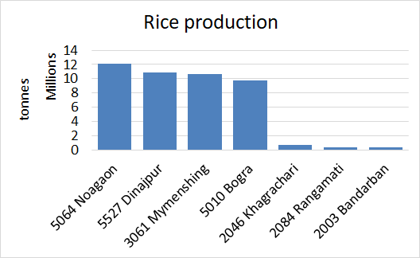
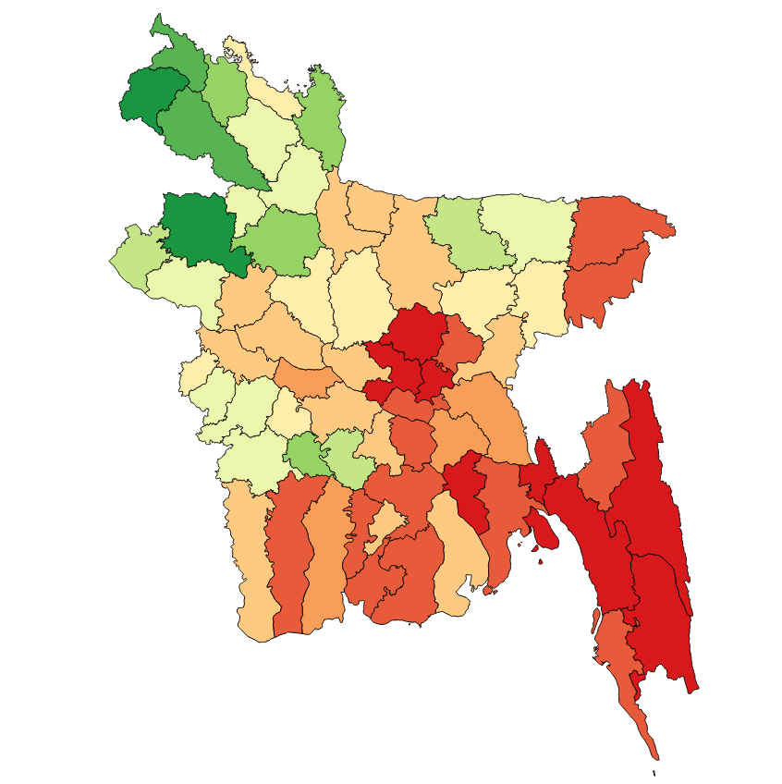
Results: Food security
Top rice
producer
Food security composite indicator (ADESA) for the 20% lowest income quantile
Red = Lower food security
Green = Higher food security
Low food security is an impact of
low rice production in combination with lower income per capita
(e.g. Chattogram)
Chattogram
Low rice production
Lower income/capita for the poor
Notes:
*Vanni add notes*

Slide 19
Data used in Metamodel
Administrative boundary (BBS, 2011)
Landuse (CEGIS, 2010)
Land types and Soil (BARC, 1999)
Crop Suitability, BARC
Meteorological (BMD, 2018 and BWDB)
FCDI-projects (BWDB, 2018)
DEM (WARPO, 2017)
Exposure data, BBS
Infrastructure owners (RHD, LGED, BWDB)
Yearbook of Agricultural Statistics-2018,BBS
MIKE11Region Model’s Output
BDP2100 Scenario
Notes:
*Vanni add notes*

Slide 20
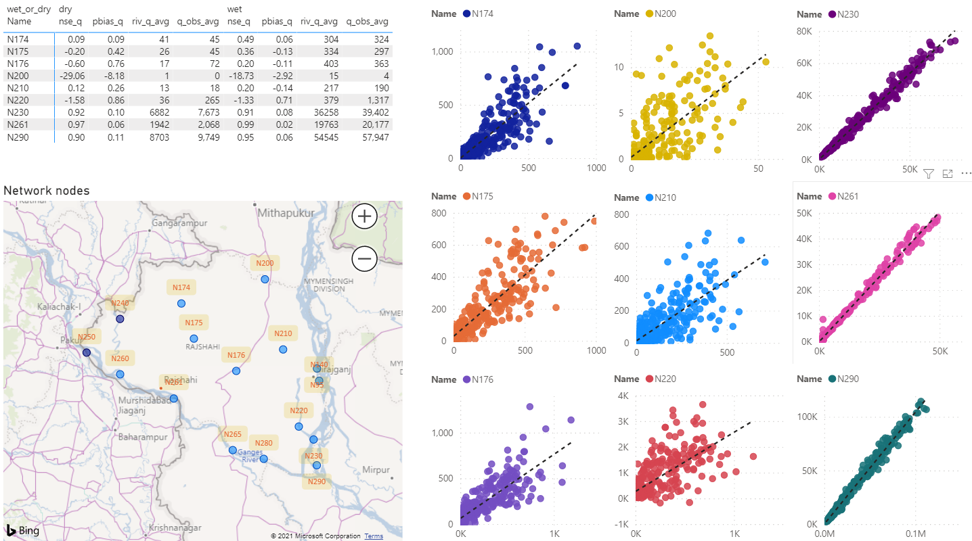
Present Status of Metamodel
Calibration has been done for NW-Region
Salinity, Fisheries and E-flow modules development ongoing
Whole country will be calibrated end of 2021
Application within SIBDP to select projects for the Basin Implementation Programs

Slide 21
Workflow to run Metamodel cases

Slide 22
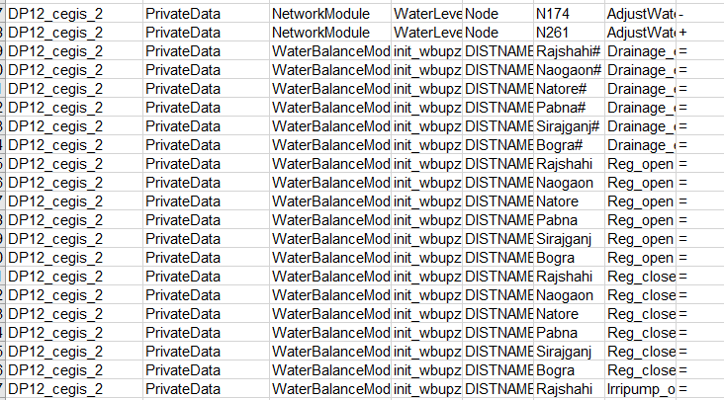
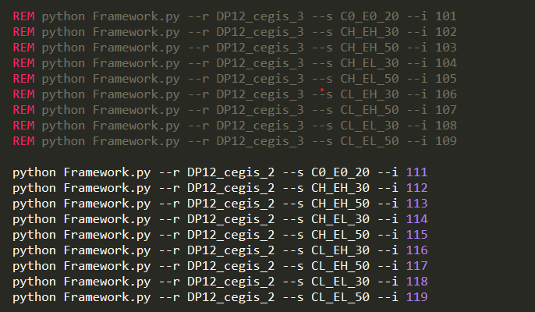
Step 1: Selection of Projects
Step 2: Formulation of Strategies/Interventions
Step 3: Selection of River location/Districts
Step 4 : Selection of Parameters to be Changed
Step 5 : Change in Parameters in “strategydefinition.csv”
Step 6 : Change in “run.bat” file
Step 7 : Simulation of Model – “run.bat” file
Step 8 : Case wise Result in the “Case” Folder
Step 9 : Combining the outputs using “CombineIndicators.py”
Step 10 : Preparing the “PowerBI” file
Step 11 : Visualization of Result

Slide 23
Project Impact Analysis
Revitalization and Restoration of Chalan Beel
Options -1,2 & 3

Slide 24
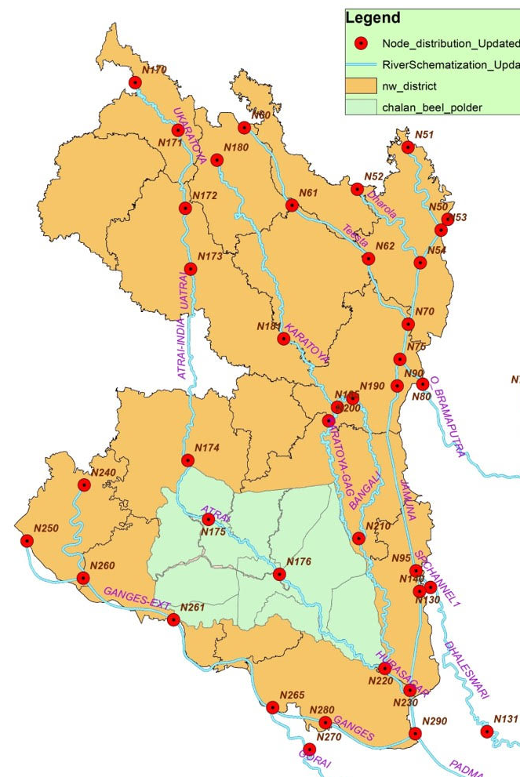
Revitalization and Restoration of Chalan Beel
Location: Pabna, Bogra, Naogaon, Natore, Rajshahi, Sirajganj
11 Polders
FCD-project
The gross area about 5,66,000 ha
Problem
Cuts and braches in embankments
Habitat and breeding grounds for the traditional fish species severely affected
Loss of flood plains and bio-diversity
Road Network vulnerable to Climate Change impacts
Notes:
Flash flooding in upstream polders, due to (unexpected) public cuts
Downstream polders suffer from submergence as a result of a backwater effect from Jamuna River.
Overland flow to Atrai river is disrupted by embankments, now all is collected in Sib-river.

Slide 25
Options Considered
Option 1: Protect the lands from flood and to extend the irrigation coverage
Option 2: Green Beel
Option 3: Climate Resilient Roads

Slide 26
Option 1
Changed parameters in Metamodel:
Node 174, decreased water level by 1m (dredging in Sib River)
Node 261, increased water level by 0.05 m (effect of Rubber Dam)
In districts- Rajshahi, Naogaon, Natore, Pabna, Sirajganj, Bogra
Increased drainage efficiency to 0.75
Regulator opened on Decade 1, closed on Decade 36.
Both SW and GW irrigation enabled
Irrigation pumping turned on Decade 1, off Decade 36
SW irrigation efficiency = 0.45, GW irrigation efficiency = 0.6
SW irrigation capacity= 3m³/s
Strategic
No breaches and no spilling over the existing embankments
Main public cuts provided with structures or weirs
Dredging in Sib river

Slide 27
Option 1
Expected Outputs:
Increase in drainage capacity of the beel area
Water is allowed inside the polders
Allowing migration of fishes and uninterrupted navigation
Decrease in Ground water depletion

Slide 28
Option2: Green Beels
Strategic Interventions:
Realigning polder boundary/embankment
Flood proofing some portions of settlement so that flood damage gets reduced

Slide 29
Option2: Green Beels
Changed parameters in Metamodel:
Selecting parcels of land containing beels/permanent waterbodies to be left outside the polder areas
Transferring calculated amount of area from “Project” to “Non-Project” Upazila-wise
Changing values in the ‘Flood Damage Function’ files
Expected Outputs:
Increase in ecosystem values and services in the beels (not computable in the MetaModel)
Reduced damage due to river floods

Slide 30
Option3: Climate Resilient Roads
Strategic Interventions
Elevating Roads at strategic segments
Using culverts, slope protection measures and pavement materials to facilitate GW infiltration and percolation
Using Polder embankments as roads (Upazila Paved Roads only)

Slide 31
Option3: Climate Resilient Roads
Changed parameters in Metamodel:
Updating data-
Length of Roads Upazila-wise
Relative height of aforementioned type of roads
Changing the values in Flood Damage Function to imitate effects of climate resilient roads
Increasing Drainage efficiency to 0.75
Expected Outputs:
Decrease in damage to river floods
Decrease in Flood Extent
Decrease in dry season river flow (increased drainage efficiency leading to more GW infiltration)

Slide 32
Meta Model Outputs: Option1,II and III

Slide 33
Meta Model Outputs: Option1 and Scenario 2050

Slide 34
Meta Model Outputs: Option1,II and III
Indicator: Flood Damage due to River and Rainfall
Scenarios:
Base 2020 and
Base 2020 with project

Slide 35
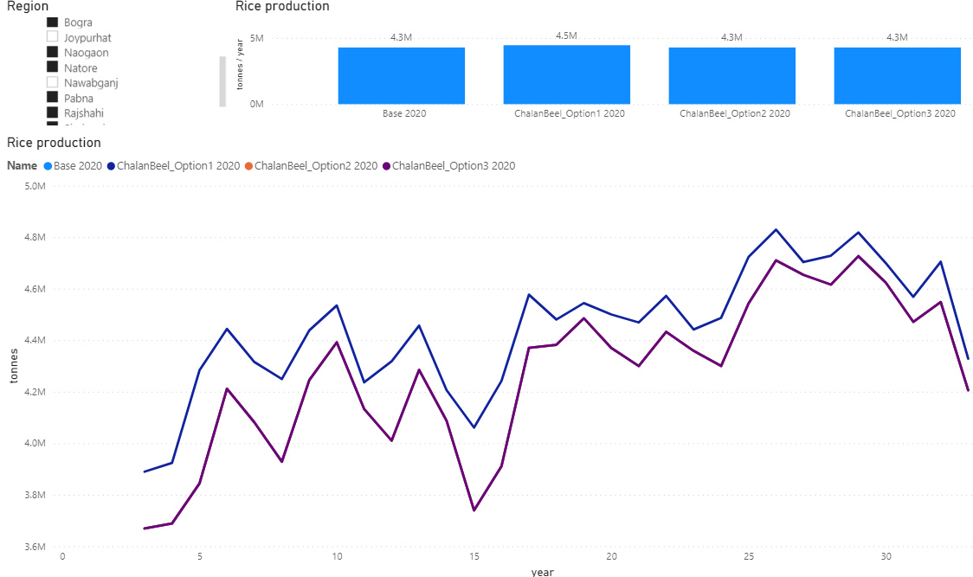
Meta Model Outputs: Option1,II and III
Indicator: Rice Crop Production
Scenarios:
Base 2020 and
Base 2020 with project

Slide 36
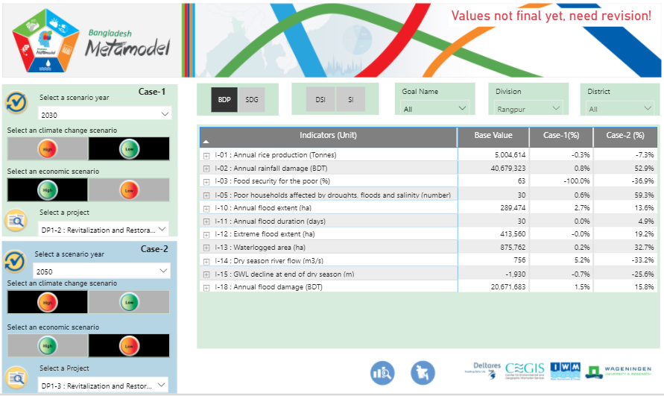
Metamodel Dashboard
Present model results for future decision-making
Evaluate and compare impacts of projects and programs
Indicator values for selected combination of
Project / program
Scenario
Time horizon
Information present in table, chart and map format
http://jcpbd.nl
Notes:
For voice:
A web-based dashboard is used for viewing model results for future decision-making. It has several dashboards such as impact explorer which supports users to evaluate and compare calculated impacts of projects and programs. Another dashboard Program Manager combines information from investment projects and showing the project implementation pathway, cost, funding sources, and contribution to BDP Goals.

Slide 37
Group Exercise
Implementation of Rationalized Water Related Interventions in Hurasagar Basin
Strategies/interventions selection

Slide 38
Implementation of Rationalized Water Related Interventions in Hurasagar Basin
Erosion along the river banks
Flood and drainage problem in the project area due to siltation
Depletion of GWT due to excessive use of GW irrigation
Drought and low flow
Vulnerability to climate change
Navigation problem due to siltation and human intervention
Lack of proper water use and management
Loss of habitat and species

Slide 39
Implementation of Rationalized Water Related Interventions in Hurasagar Basin
Interventions
Excavation of Karotoa, Atrai River and Ganges
Encouraging surface water irrigation at Dinajpur, Kurigram, Lalmonirhat, Nawabganj, Rajshahi, Naogaon specially in drought prone area
Reducing ground water irrigation at Dinajpur, Kurigram, Lalmonirhat, Nawabganj, Rajshahi, Naogaon specially in drought prone area.
Stregthening embankment at flood prone zone.
Decrease in flood extent and flood damage
Increase Surface water Irrigation
Decrease groundwater abstraction
Increasing agricultural production
Increasing fisheries production
Increasing livestock production
Increasing fresh water supply
Reducing Poverty
Flood proofing of houses in flood plains
Expected Outputs

Slide 40
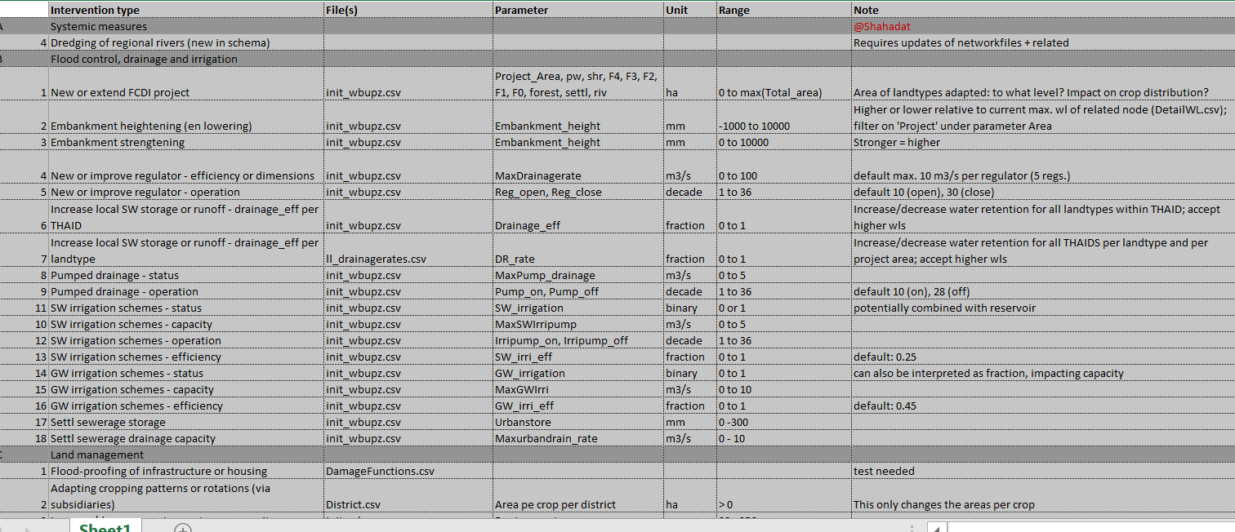
Measures Parameters

Slide 41
Thank You

